Slide 1
Pair Programming

Slide 2
How to Pair
Start with a small, reasonably well-defined task before you sit down
Rely on your partner, support your partner
Talk and sync up frequently
Celebrate as you complete tasks and overcome problems
Switch roles often—at least every 15 minutes
http://www.wikihow.com/Pair-Program

Slide 3
Pairing Infrastructure

Slide 4
Monitors
One Monitor
Both Pairs are looking at the same location
Smaller Desktop
Two Monitors – Mirrored
Pairs not looking at the same location
Smaller Desktop
Conversations don’t come as easily
Two Monitors – Spanned
Both Pairs are looking at the same location
One Huge Desktop
Enables more non-verbal communication

Slide 5
Keyboard and Mouse
One Shared
Encourages Communication
Must either express yourself or ask for the keyboard
Two (One for each person)
Faster to take control
Less physical movement
Less germ spreading!

Slide 6
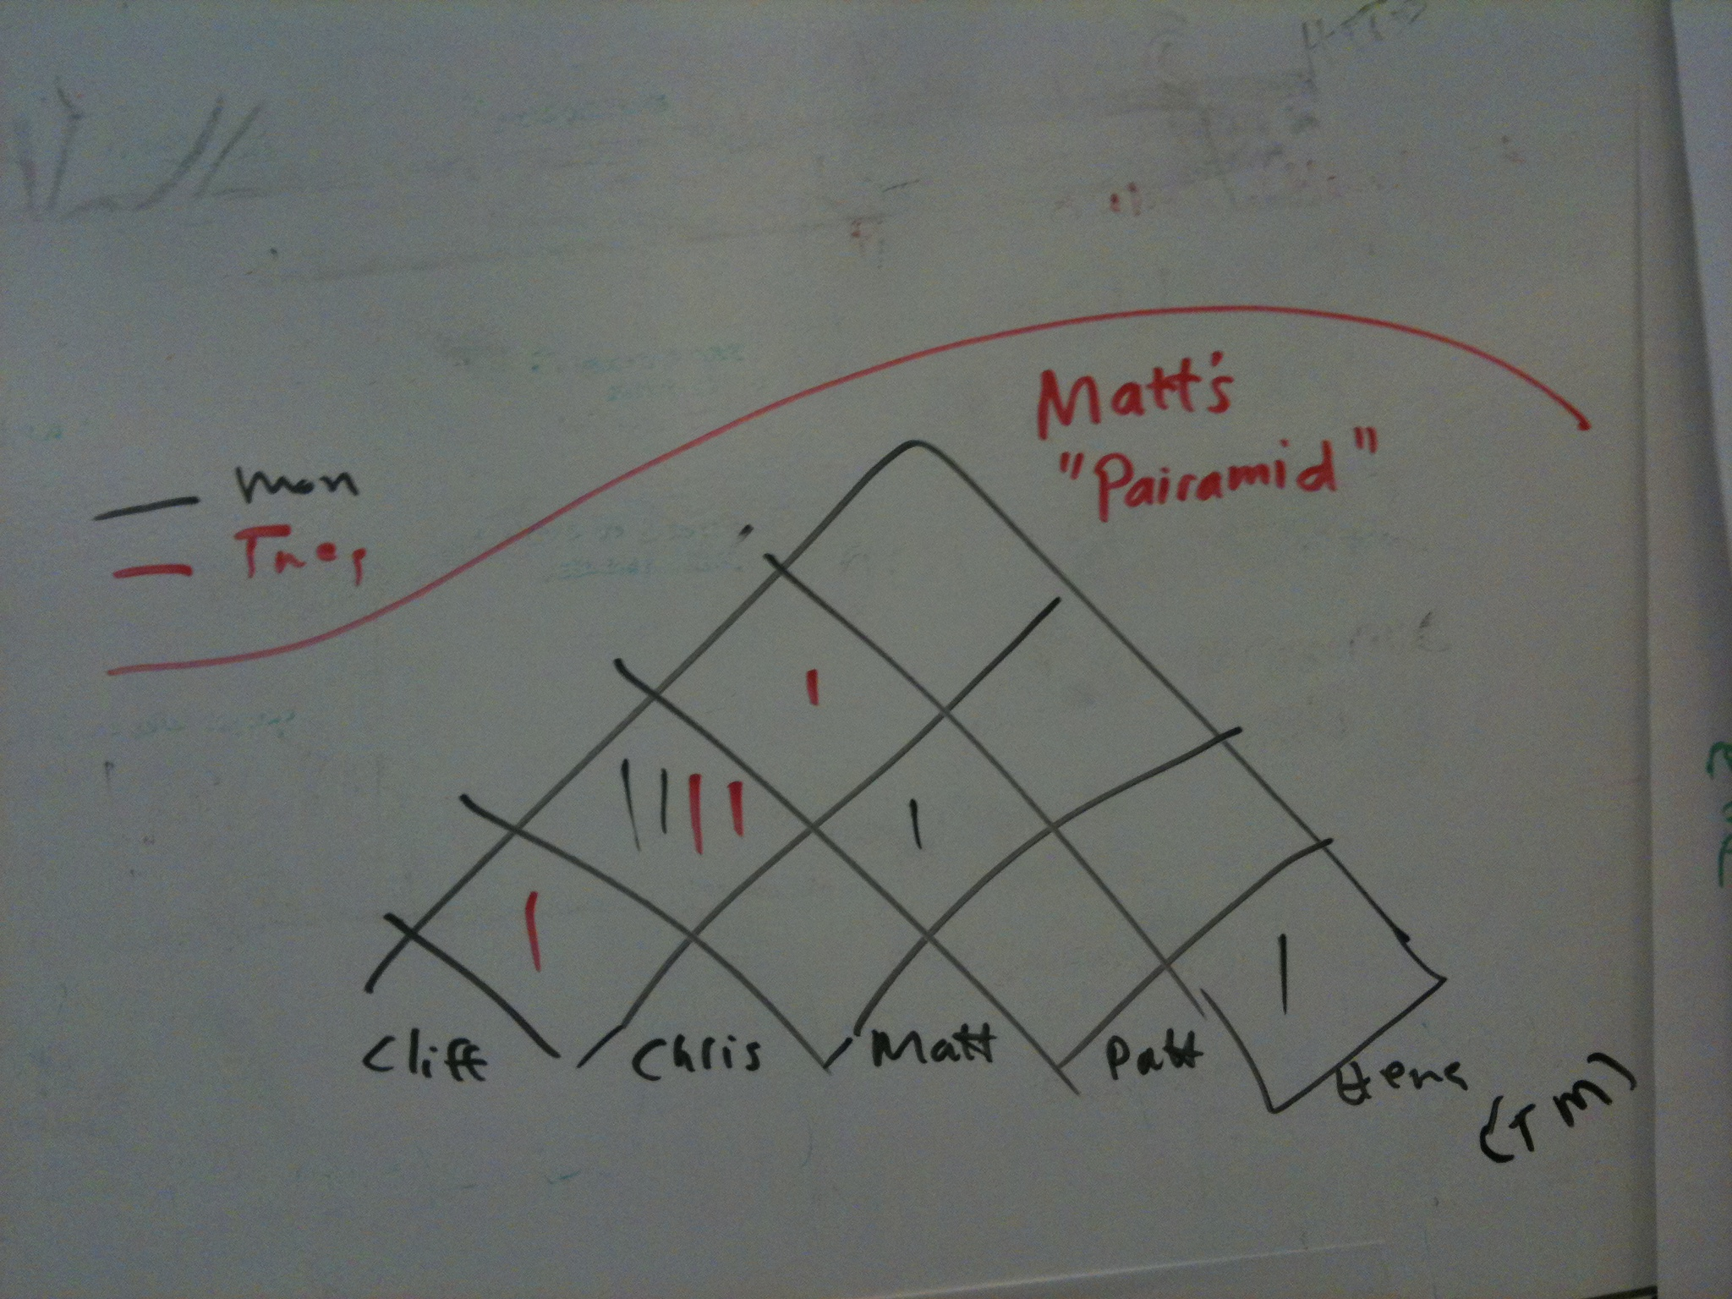
Pair Rotation Techniques
Egg Timer / Chess Clock
Encourages rotation of roles within a pair
Driver swapping
Pair Stair/Pairamid
Encourages working with everybody
H
G |  |  |  |  |  |  |  | 1
F |  |  |  |  |  |  | 2 | 3
E |  |  |  |  |  | 1 | 3
D |  |  |  |  | 2
C |  |  |  | 1
B |  |  | 2 | 3
A |  | 1 | 3 |  |  |  |  | 2
 | A | B | C | D | E | F | G | H

Slide 7
Story #1
As a customer
I want to see my frequent renter points for this order
So I know when I'm eligible for a free rental
Acceptance criteria
One point per rental
Display on statement after checkout
Display on statement history
Notes:
Acceptance criteria
One point per rental
Display on statement after checkout
Display on statement history
Display points only for current order

Slide 8
Styles
Pairing

Slide 9
Pairing Styles
Driver and Navigator
Driver works tactically, Navigator works strategically
Easiest to start with
Roles should be swapped as frequently as possible

Slide 10
Pairing Styles
Ping-Pong
'A' writes a test, 'B' makes it green.
Next 'B' writes the test, 'A' makes it green
A mix of Pairing and Test Driven Development (TDD)

Slide 11
Pairing Styles
Ball and Board
One person controls the mouse (The Ball)
The other person controls the keyboard (The Board)
Useful for forcing yourself to learn keyboard shortcuts
You either learn them, or have to ask the Ball to do things for you

